Slide 1
Library Management System Analysis
SQL Queries and Analysis
Presented by
KANDUKURI JASWANTH

Slide 2
Introduction
Objective:
Goal: The objective of this presentation is to analyze the library management system’s data using SQL queries to answer key questions related to book loans, borrowers, and library branches.
Tools Used: SQL for data querying, database management systems for executing the queries.

Slide 3
Database Schema
Here we introduce the structure of the database and the various tables:
Tables in the Database:
Books — Contains details about books such as title, author, and branch they belong to.
Borrowers — Stores information about individuals borrowing books.
Book Loans — Represents transactions where books are borrowed from the library.
library branch— Information about each library branch.
Publishers: Here Books who publish in online or offline books.
Book copies — Contains details about Book copies such as copies id,books id,
Branch id, no of copies they belong to.

Slide 4
Database Schema
Key Fields:
Books: book_BookID, book_Title, book_PublisherName
Borrowers: borrower_CardNo, borrower_BorrowerName, borrower_BorrowerAddress, borrower_BorrowerPhone
Book_loans:book_loans_LoanID,book_loans_BranchID, book_loans_CardNo, book_loans_DateOut, book_loans_DueDate
library branch:library_branch_BranchID, library_branch_BranchName, library_branch_BranchAddress
Publishers: publisher_PublisherID, publisher_PublisherName, publisher_PublisherAddress, publisher_PublisherPhone
Book copies —book_copies_ID, book_copies_BookID, book_copies_BranchID, book_copies_No_Of_Copies

Slide 5
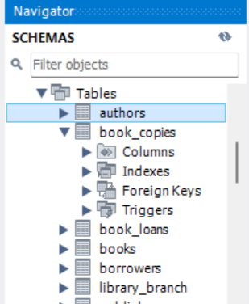
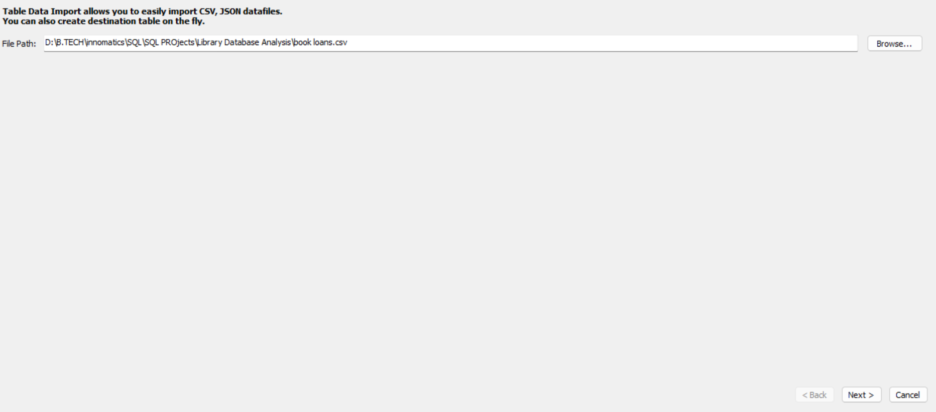
Data Import
Here, you'll explain how the data was imported into the database:
Data Import Example (SQL Query for CSV import):
Click on the authors right click

Slide 6
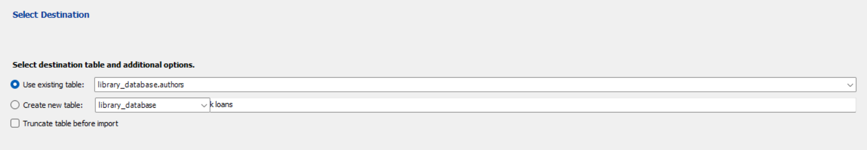
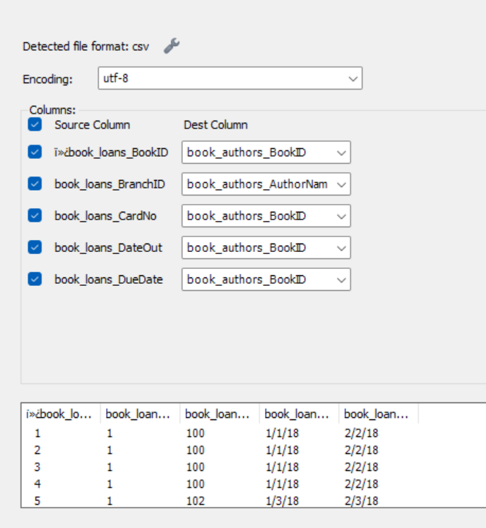
SQL Query for CSV import:
LOAD DATA INFILE Authors.csv'
INTO TABLE Books
FIELDS TERMINATED BY ','
LINES TERMINATED BY '\n'
IGNORE 1 ROWS;
Explanation: This command loads data from a
CSV file into the table in the Authors database. Similar queries can
be used to load data Into the Borrowers, books
Book Loans, and Library Branches, book_copies, publishers, tables

Slide 7
EER Diagram
This slide contains an Entity-Relationship (ER) diagram
that visually represents the relationships between the tables:
Relationships:
Books and Branches are connected through BranchID
(i.e., each book belongs to a specific library branch).
Borrowers and Loans are connected through BorrowerID (i.e., a borrower can have many loans).
Books and Loans are connected through BookID (i.e., a book can be loaned out multiple times).

Slide 8
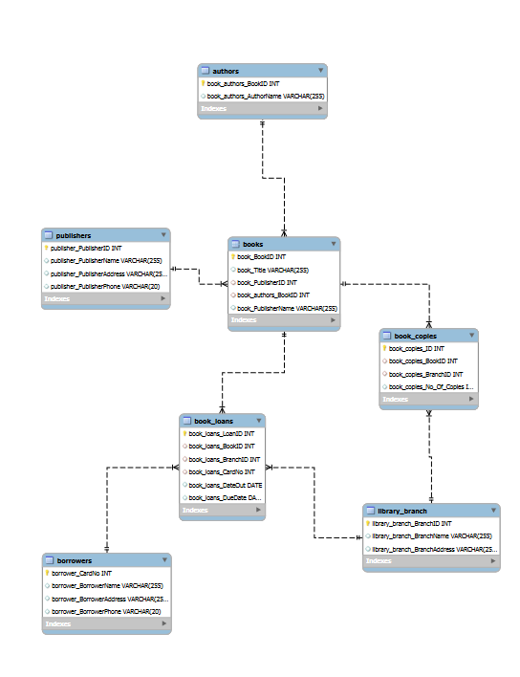
EER Diagram

Slide 9
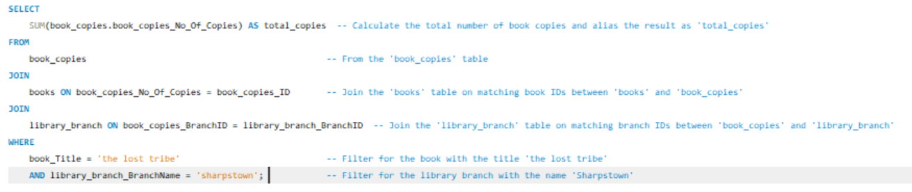
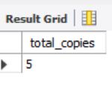
Task Questions and Queries (Each with Detailed Explanation):
Task 1: "The Lost Tribe" Copies in Sharpstown
Question: How many copies of the book titled "The Lost Tribe" are owned by the library branch named "Sharpstown"?
SQL Query:
This SQL query sums the total number of copies of the book titled "The Lost Tribe" available in the "Sharpstown" library branch by joining the `book_copies`, `books`, and `library_branch` tables.

Slide 10
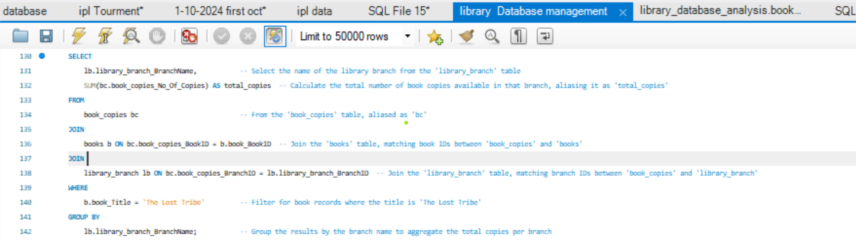
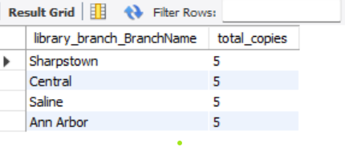
Task 2: "The Lost Tribe" Copies in Each Branch Question: How many copies of the book titled "The Lost Tribe" are owned by each library branch? The query retrieves the total number of copies of "The Lost Tribe" available at each library branch by joining the book_copies, books, and library_branch tables and grouping by branch names. Output:

Slide 11
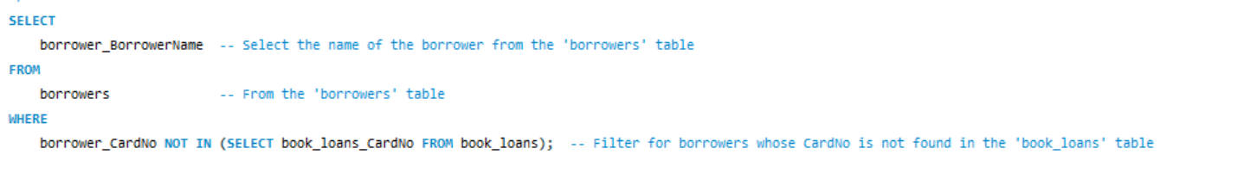
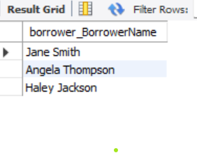
Task 3: Borrowers with No Checked-Out Books .
Question: Retrieve the names of all borrowers who do not have any books checked out.
To retrieve names of borrowers without checked-out books, use a LEFT JOIN or subquery. The queries identify borrowers whose CardNo is not present in the book_loans table, effectively filtering those without active loans.
Output:

Slide 12
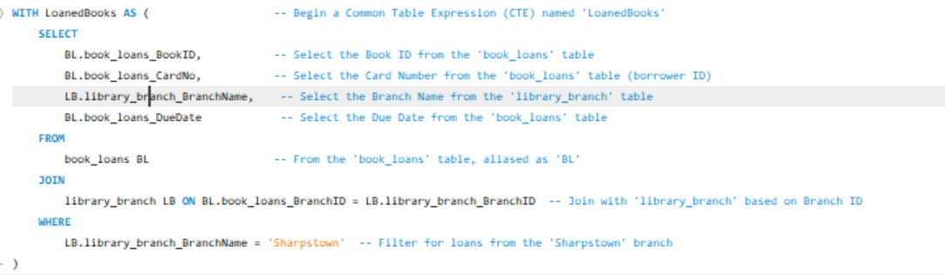
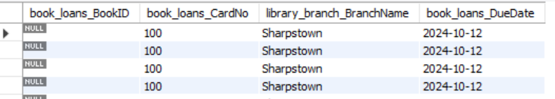
Task 4: Loan Details in Sharpstown
Question: For each book loaned out from the "Sharpstown" branch and whose DueDate is 2/3/18, retrieve the book title, the borrower's name, and the borrower's address.
In below SQL query retrieves details of books loaned from the 'Sharpstown' library branch, including book ID, card number, branch name, and due date by joining the book loans and library branch tables.
Multiple JOIN operations are used to connect the Books, Borrowers, Loans, and Branches tables.
The WHERE clause restricts the results to loans from the "Sharpstown" branch and with a due date of 2/3/18.
The query retrieves the book title, borrower's name, and address.

Slide 13
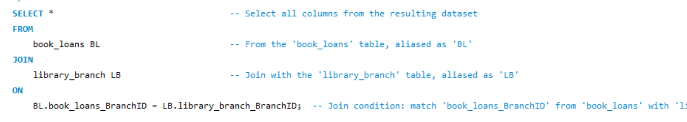
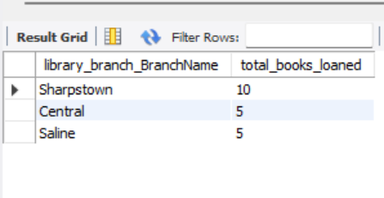
Task 5: Total Books Loaned by Branch
Question: For each library branch, retrieve the branch name and the total number of books loaned out from that branch.
SQL Query:
In aboveSQL query retrieves all columns (SELECT *) from the book_loans (BL) and library_branch (LB) tables by joining them on the matching BranchID fields (book_loans_BranchID and library_branch_BranchID). The purpose is to combine related data from both tables.
Output:

Slide 14
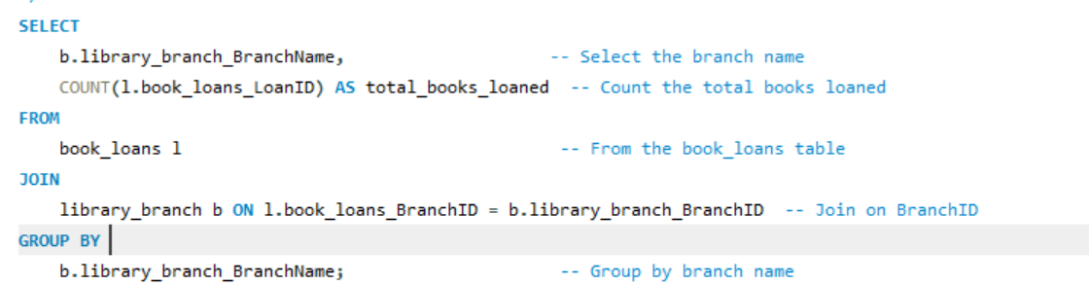
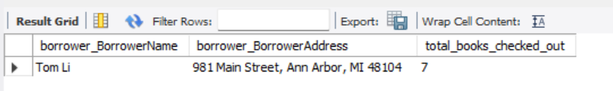
Task 6: Borrowers with More Than 5 Books
Question: Retrieve the names, addresses, and number of books checked out for all borrowers who have more than five books checked out.
SQL Query:
This SQL query retrieves each library branch's name and the total number of books loaned. It joins the book_loans and library_branch tables based on BranchID, grouping results by branch to count loans per branch.
Output:

Slide 15

Task 7: Stephen King Books in Central Branch
Question: For each book authored by "Stephen King," retrieve the title and the number of copies owned by the library branch whose name is "Central."
SELECT b.book_Title, -- Select the title of the book from the 'books' table bc.book_copies_No_Of_Copies -- Select the number of copies available from the 'book_copies' table
FROM books b -- From the 'books' table, aliased as 'b'JOIN authors a ON b.book_BookID = a.book_authors_BookID -- Join the 'authors' table, matching book IDs between 'books' and 'authors'JOIN book_copies bc ON b.book_BookID = bc.book_copies_ID -- Join the 'book_copies' table, matching book IDs between 'books' and 'book_copies'JOIN library_branch lb ON bc.book_copies_BranchID = lb.library_branch_BranchID -- Join the 'library_branch' table, matching branch IDs between 'book_copies' and 'library_branch'WHERE a.book_authors_AuthorName = 'Stephen King'; -- Filter for books authored by 'Stephen King’
The provided SQL query retrieves the titles and number of copies for books authored by "Stephen King." It joins the books, authors, book_copies, and library_branch tables based on their relationships to filter and display relevant data. This helps identify available titles by the author in the library's collection.
Output:

Slide 16
Summary of overall Findings
The queries addressed various aspects of library management, including book availability, borrower activity, and branch-specific book loans.By using SQL's JOIN, GROUP BY, and filtering mechanisms, we efficiently retrieved and summarized complex data from multiple interconnected tables.

Slide 17
Conclusion
In this set of SQL queries, we effectively retrieved valuable insights from a library database, focusing on book availability, borrower activity, and branch-specific operations. Using techniques like JOIN, GROUP BY, COUNT, and filtering with WHERE clauses, we answered key questions about book ownership, borrower activity, and loan details across branches. The queries demonstrated efficient data retrieval and grouping, providing essential information for library management, such as monitoring book circulation and borrower behavior, ultimately aiding in effective inventory and loan management.

Slide 18
Thank you

